Slide 1
Scheduling Algorithms
CPU scheduling deals with the problem of deciding which of the processes in the ready queue is to be allocated the CPU. There are many different CPU-scheduling algorithms. There are six popular process scheduling algorithms which we are going to discuss:
First-Come, First-Served (FCFS) Scheduling
Shortest-Job-Next (SJN) Scheduling
Priority Scheduling
Shortest Remaining Time
Round Robin (RR) Scheduling
Multiple-Level Queues Scheduling

Slide 2
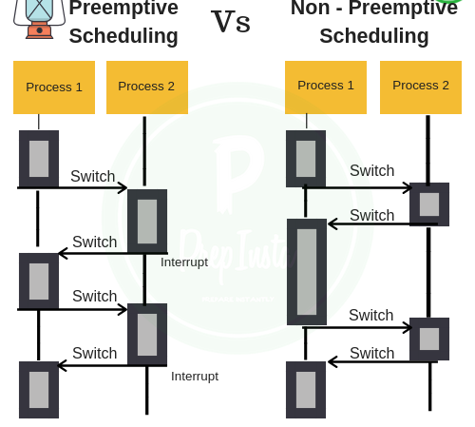
These algorithms are either non-preemptive or preemptive. Non-preemptive algorithms are designed so that once a process enters the running state; it cannot be preempted until it completes its allotted time, whereas the preemptive scheduling is based on priority where a scheduler may preempt a low priority running process anytime when a high priority process enters into a ready state.

Slide 3

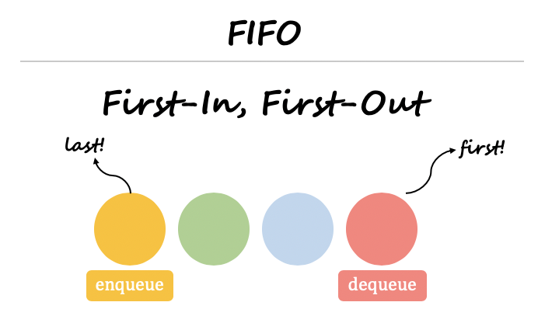
First-Come, First-Served (FCFS) Scheduling
Jobs are executed on first come, first served basis.
It is a non-preemptive scheduling algorithm.
Easy to understand and implement.
Its implementation is based on FIFO(first in first out) queue.
Poor in performance, as average wait time is high.

Slide 4
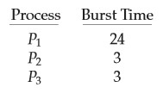

Consider the following set of processes that arrive at time 0, with the length of the CPU burst given in milliseconds:
If the processes arrive in the order P1, P2, P3, and are served in FCFS order, we get the result shown in the following chart that illustrates a particular schedule, including the start and ﬁnish times of each of the participating processes:

Slide 5
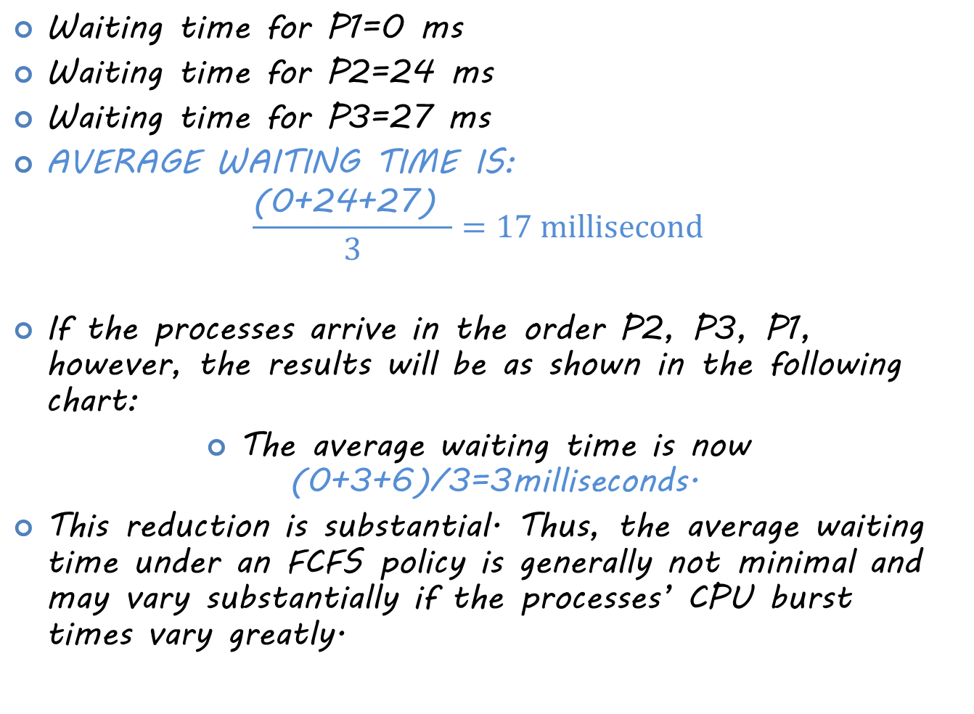
Waiting time for P1=0 ms
Waiting time for P2=24 ms
Waiting time for P3=27 ms
AVERAGE WAITING TIME IS:
$$\frac{\text{(0+24+27) }}{3}=17 millisecond$$
If the processes arrive in the order P2, P3, P1, however, the results will be as shown in the following chart:
The average waiting time is now (0+3+6)/3=3milliseconds.
This reduction is substantial. Thus, the average waiting time under an FCFS policy is generally not minimal and may vary substantially if the processes’ CPU burst times vary greatly.

Slide 6

Shortest Job Next (SJN)
This is also known as shortest job first, or SJF.
This is a non-preemptive scheduling algorithm.
Best approach to minimize waiting time.
Easy to implement in Batch systems where required CPU time is known in advance.
The processer should know in advance how much time a process will take.

Slide 7
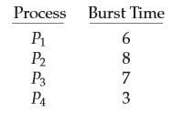

As an example of SJF scheduling, consider the following set of processes, with the length of the CPU burst given in milliseconds:
Using SJF scheduling, we would schedule these processes according to the following chart:
The waiting time is 3 milliseconds for process P1, 16 milliseconds for process P2, 9 milliseconds for process P3, and 0 milliseconds for process P4. Thus, the average waiting time is (3 + 16 + 9 + 0)/4 = 7 milliseconds.
Notes:
By comparison, if we were using the FCFS scheduling scheme, the average waiting time would be 10.25 milliseconds.

Slide 8

Priority Based Scheduling
Priority scheduling is a non-preemptive algorithm and one of the most common scheduling algorithms in batch systems.
Each process is assigned a priority. Process with highest priority is to be executed first and so on.
Processes with same priority are executed on first come first served basis.
Priority can be decided based on memory requirements, time requirements or any other resource requirement.

Slide 9
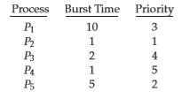

As an example, consider the following set of processes, assumed to have arrived at time 0 in the order P1, P2, ··· , P5, with the length of the CPU burst given in milliseconds:
Using priority scheduling, we would schedule these processes according to the following chart:
The average waiting time is 8.2 milliseconds.

Slide 10

A major problem with priority scheduling algorithms is indeﬁnite blocking, or starvation. A process that is ready to run but waiting for the CPU can be considered blocked. A priority scheduling algorithm can leave some low priority processes waiting indeﬁnitely. In a heavily loaded computer system, a steady stream of higher-priority processes can prevent a low-priority process from ever getting the CPU.

Slide 11
Shortest Remaining Time
Shortest remaining time (SRT) is the preemptive version of the SJN algorithm.
The processor is allocated to the job closest to completion but it can be preempted by a newer ready job with shorter time to completion.
Impossible to implement in interactive systems where required CPU time is not known.
It is often used in batch environments where short jobs need to be given preference.

Slide 12
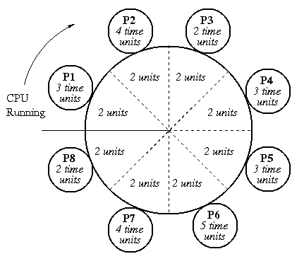
Round Robin Scheduling
Round Robin is a preemptive process scheduling algorithm.
Each process is provided a fix time to execute; it is called a quantum.
Once a process is executed for a given time period, it is preempted and other process executes for a given time period.
Context switching is used to save states of preempted processes.

Slide 13


The average waiting time under the RR policy is often long. Consider the following set of processes that arrive at time 0, with the length of the CPU burst given in milliseconds:
If we use a time quantum of 4 milliseconds, then process P1 gets the ﬁrst 4 milliseconds. Since it requires another 20 milliseconds, it is preempted after the ﬁrst time quantum, and the CPU is given to the next process in the queue, process P2. Process P2 does not need 4 milliseconds, so it quits before its time quantum expires. The CPU is then given to the next process, process P3. Once each process has received 1 time quantum, the CPU is returned to process P1 for an additional time quantum. The resulting RR schedule is as follows:

Slide 14
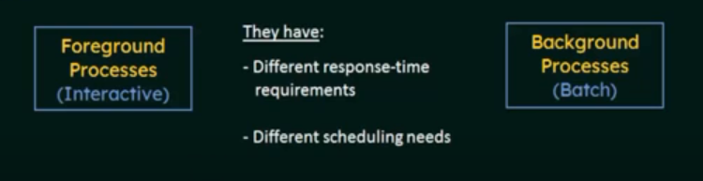
Multiple-Level Queues Scheduling
Multiple-level queues are not an independent scheduling algorithm. They make use of other existing algorithms to group and schedule jobs with common characteristics.
Multiple queues are maintained for processes with common characteristics.
Each queue can have its own scheduling algorithms.
Priorities are assigned to each queue.

Slide 15
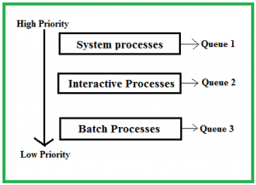
Interactive processes might be scheduled by an RR algorithm, while the batch processes is scheduled by FCFS algorithm. The Process Scheduler then alternately selects jobs from each queue and assigns them to the CPU based on the algorithm assigned to the queue.

